Slide 1
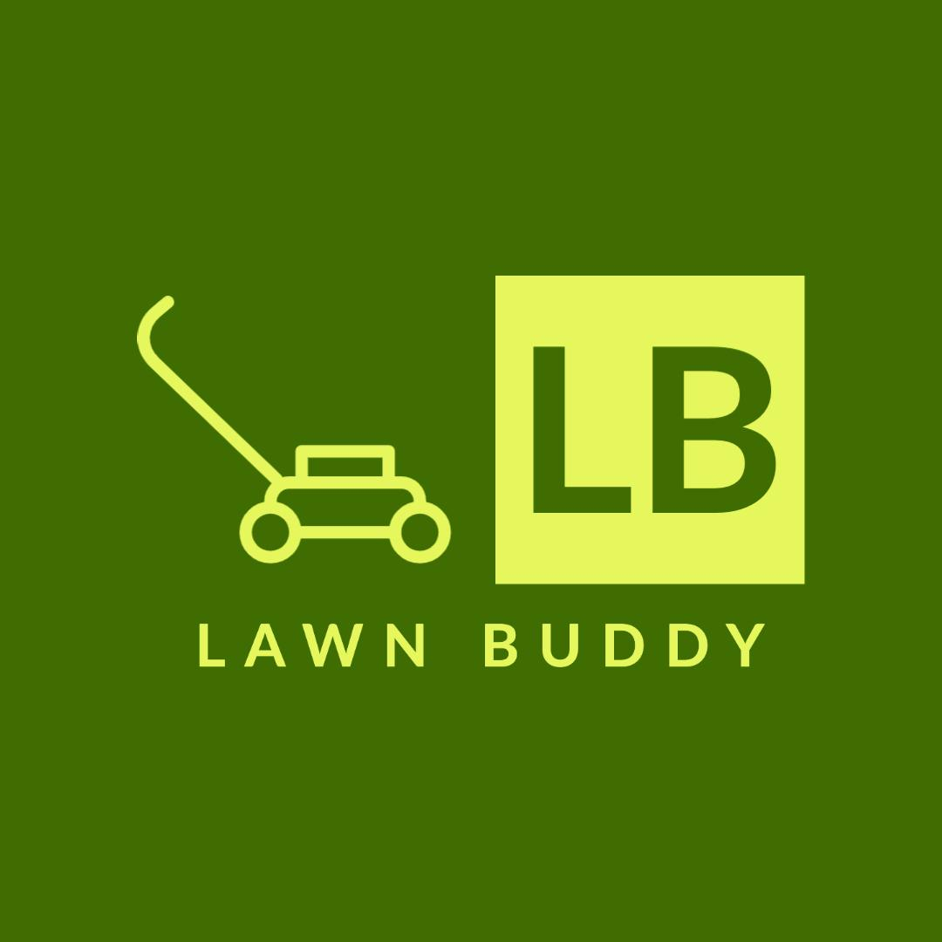
Lawn Buddy
“The cutting hedge technology”
Assignment 2: Cutting Edge Tech Solutions
Enaas Ahmad, Gasser Ahmed, Hamnah Rizwan
BIT 5594
7/2/2022

Slide 2
Object Recognition
Lawn Buddy uses the cutting edge technology of object recognition, a principle of machine learning and deep learning where computer vision technique allows users to identify and locate objects in an image.
Object recognition consists of 4 processes:
Image classification
Tagging
Object detection
Segmentation
Classification and tagging focus on identifying the contents of an image.
Detection and segmentation focus on finding the location of objects in an image after the particular objects have been recognized.
Object recognition can take place through machine learning or deep learning (a specialized form of machine learning).
Machine learning and deep learning will give the same outputs, but differ in their methodology.
If a user has a lot of data and strong hardware, deep learning can be used, otherwise, machine learning should be used.

Slide 3
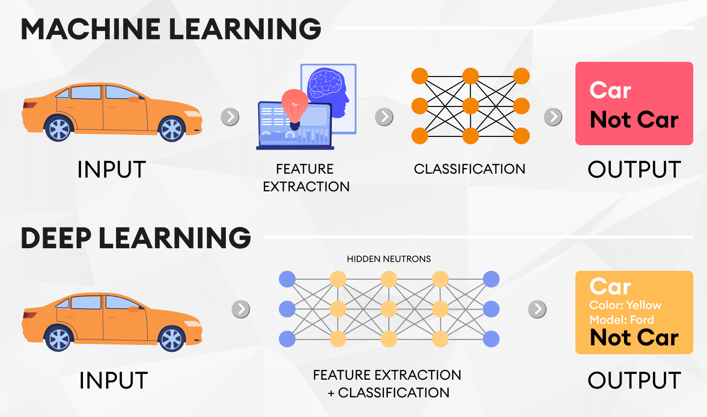
How Object Recognition Works
https://blog.superannotate.com/object-detection-with-deep-learning/

Slide 4
Lawn Buddy Uses Object Recognition
Lawn Buddy has a thorough dataset of all types of lawns in order to have the most accurate reading of the image recognition. By analyzing the pixels in the image recognition, Lawn Buddy can interpret and understand the logistical nature of lawn care services needed.
By analyzing the dataset, Lawn Buddy uses the criteria of computer vision in order to break down the classification, localization and tagging. Lawn buddy uses the classification feature to detect the lawn, and the use of localization to determine lawn size, and the tagging feature to further find the lawn quality, which is measured through lawn color, and blade length which determines when the lawn needs to be trimmed.
Lawn quality: measured by the appearance and color of the lawn. Ex. yellow lawn = poor quality
Blade length: measured by analyzing the individual blade. Ex. blade > 3 inches = long, time for maintenance
Lawn size: measured by the phone's AR feature. Ex. 20 x 15 sq. ft.
Lawn terrain: measured by the topography of the yard. Ex. hills = non-flat terrain
Lawn Buddy uses location services to determine weather patterns like rain and drought to determine the rate of grass growth and then lawn maintenance scheduling.

Slide 5
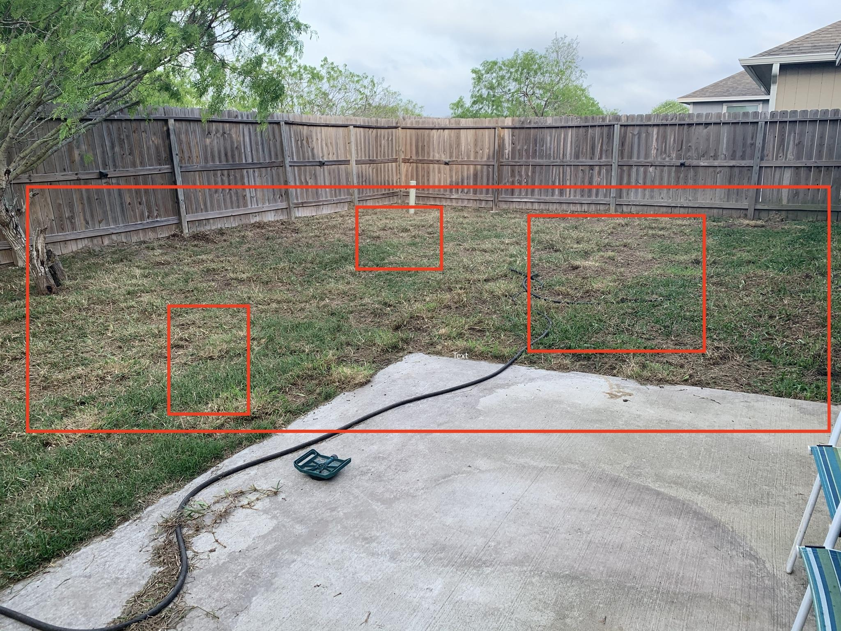
LB’s Live Image Recognition Feature
Lawn size: 20 x 35 sq. ft
Lawn quality: poor
Lawn terrain: flat
Blade length: 5 inches
Continue

Slide 6




Object Recognition and E-commerce
Online Shopping
Social Media
Explicit Content
Counterfeit Products
Allow online shoppers to upload an image of an item they are searching for and find thousands of products that fulfill their needs
Differentiate between products, objects, and facial expressions to identify images of products people like and suggests ads accordingly
Detect nudity and explicit content in the images that customers upload for reviews
Detect fake logos that are trying to pass as legitimate brands and automatically flag the products so that shoppers do not continue to purchase
“Image recognition is helping retailers to expand consumer reach, offer insights into trends, and improve customers’ online shopping experience for the e-commerce industry.”

Slide 7


Object Recognition Benefits and Risks
Benefits
Risks
Improved customer experience/engagement
Improved app productivity
Accessibility friendly services
Visual shopping
Personalized content
Speeds up customer purchase decisions
Boosts conversion rates and revenue
Decreases bounce rate and maximizes earnings and remain competitive
Illumination changes in setting
Occlusion (one object comes in front of another)
Clutter (objects are surrounded by other objects)
Dynamic background
Data security
Performance issues (ex.speed, lack of software)
Minimum specifications requirement (camera, sensors, AR)
High cost of development (research, production, data infrastructure, testing)
Customer basic technical skills needed
“According to a Kissmetrics study, a whopping 93% of consumers consider visual aids to be decisive for their purchase decisions.”

Slide 8

Use Case: Pinterest Lens
The Case: Pinterest, a popular image-sharing social media platform well known for its “pin boards,” launched Pinterest Lens in 2017. With the increasing growth in retailers displaying products on the app, the platform developed an identification method for its users to easily identify a product and direct to its location via a link, including suggestions for similar products. The app announced that it can identify more than 2.5 billion objects (which is significant when compared to Google Lens, which only recognizes 1.5 billion products).
How the Technology was Used: Through the use of object recognition technology, users can simply take a photo within the app and be directed to that exact product and similar items. There is also a “shop” tab that links to where the item is sold. The technology works in two stages. Firstly, it understands the query by identifying the object’s most noticeable features, also done with the help of metadata. The second stage is displaying the results. This is done using three sources which are: conducting an image search, an object search for similar items, and a visual search for similar styles.
Results: Studies found that 80% of users start with using Pinterest Lens when shopping, and 61% find that Pinterest Lens provides an enhanced experience for browsing products. Lens was also identified to contribute to the platform’s over 600 million searches.

Slide 9
Hypothetical Situation
A differently abled person wishes to take care of his lawn but physically can not do so. He wants to find the best price in his area, so he downloads Lawn Buddy. He uses the object recognition technology that is featured in the app in order to scan his lawn. From his window, he is able to get a good image of his front yard and the Lawn Buddy app detects his lawn size, lawn terrain, lawn quality, and lawn blade length. By determining the four criteria, Lawn Buddy will automatically create a schedule for lawn maintenance, as well as suggesting a lawn professional and his price ranges. The individual will confirm the scheduling details, and lawn criteria, and his lawn will be under the care of Lawn Buddy for the length of time he desires. Lawn Buddy is able to provide lawn maintenance up to once year in advance.
On the scheduled day, the lawn professional comes to your domicile, and provides the lawn care services needed and leaves. His payment and tip is fulfilled through the app, so no contact needed.
By using the image recognition technology from Lawn Buddy, the checkout experience is more efficient and user-friendly, especially for sick, elderly or differently abled persons that like to enjoy a maintained lawn.

Slide 10


UML Use Case Diagram
Lawn Buddy
Authentication
Scan Lawn
Dataset
<<selects>>
Service
<<confirms>>
Lawn Professional
Customer
Checkout
Credit Payment Service
Login

Slide 11
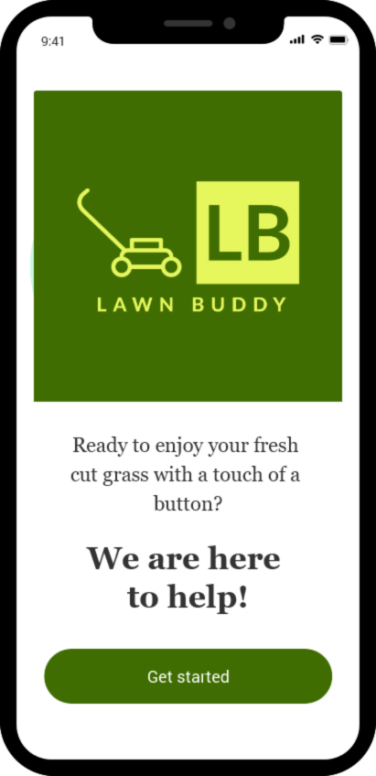
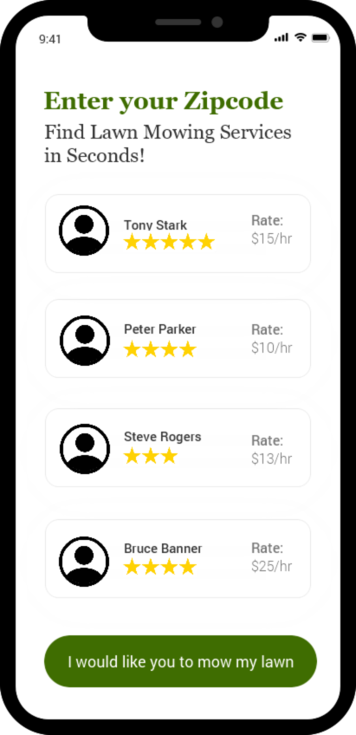
How it Works
Scan
Query
Final Output
Lawn terrain: flat
Suggested Lawn Professional
Lawn quality:
poor
Days
Blade length:
5 inches
Mon
Wed
Fri
Duration
Lawn size: 20 x 35 sq. ft
Weekly
Monthly
Continue to pricing

Slide 12
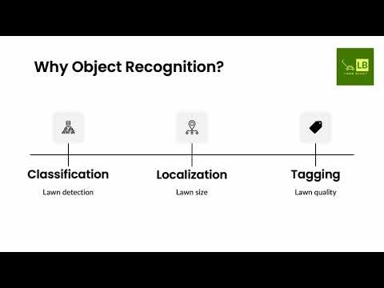

Slide 13
Appendix
https://www.folio3.ai/blog/object-recognition-explained/
https://blog.superannotate.com/object-detection-with-deep-learning/
https://pyxl.com/blog/image-recognition-in-ecommerce/
https://icons8.com
https://venturebeat.com/2019/09/17/pinterests-lens-can-now-recognize-2-5-billion-home-and-fashion-objects/
https://newsroom.pinterest.com/en/post/shop-with-your-camera-pinterest-launches-shop-tab-on-lens-visual-search-results
https://medium.com/swlh/pinterest-lens-what-the-latest-updates-mean-for-visual-search-59642cb6b326
https://www.fritz.ai/object-detection/
https://www.reddit.com/r/lawncare/comments/fiz9y9/restoring_bad_lawn/
https://imgur.com/a/F5DEk45
https://www.aiacceleratorinstitute.com/powering-e-commerce-experiences-with-computer-vision/
https://indatalabs.com/blog/image-recognition-for-e-commerce

